Slide 1
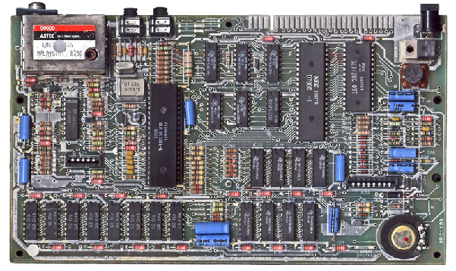
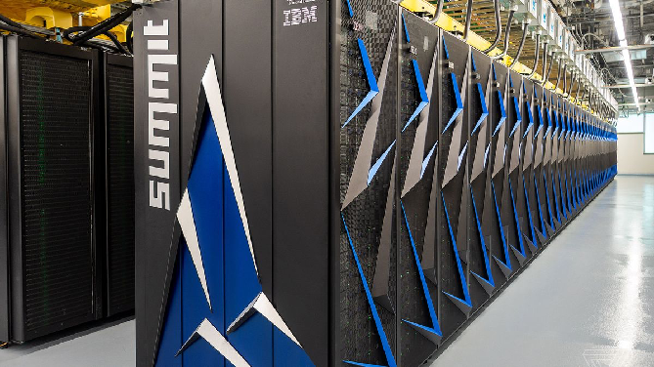
ENGR 151
An (accelerated) introduction to computers and programming
Lecture 8 - MATLAB: Project 2 briefing and Matlab review

Slide 2
Contents
Project 2
Midterm 1 review

Slide 3
Project 2
Will involve putting together the things we’ve learned in this first third of the course:
selection, iteration
procedural abstraction (using functions)
image processing and manipulation
vectorized operations
File IO
To make a more complex program

Slide 4
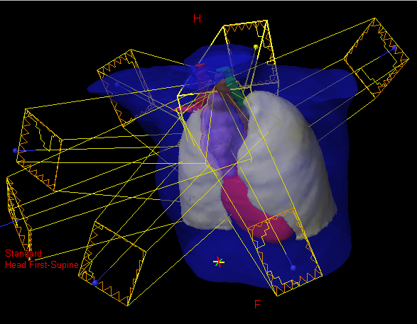
Project 2: Modeling of radiation dose for cancer treatment
Thanks to
Prof. Martha Matuszak
(UM Director of Advanced Treatment Planning, Department of Radiation Oncology) for background material

Slide 5
Why Radiation Therapy for Cancer?
Radiation kills cells by causing DNA damage that leads to cell inactivation or death
Cells are typically the most sensitive to DNA damage from radiation during reproduction
Cancer cells typically reproduce more quickly than healthy tissues
Does not cause indirect hair loss (that’s chemotherapy)

Slide 6
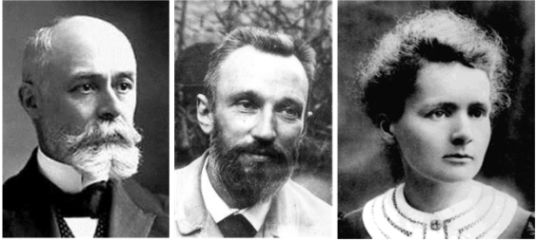
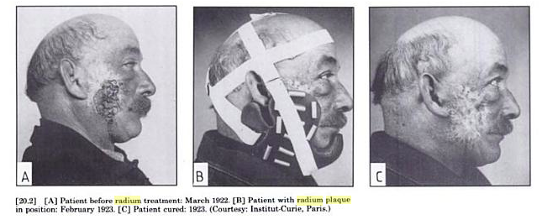
Early Use of Radioactive Sources for Medical Use
In 1898, the Curies isolated radium
Radium plaque used in 1923
Does not cause indirect hair loss (that’s chemotherapy)
Mould. A Century of X-Rays and Radioactivity in Medicine. 1993
Notes:
In late 19th century Curies isolated radium - naturally occurring radioactive metal, emits alpha, beta particles and gamma rays
Fluorescence - glow in night - paint, people (painters) are sick
They understand the radiation can damage cells
Early years they use radium plaque to irradiate the tumor
Chemotherapy vs radioactive therapy: less hair loss

Slide 7
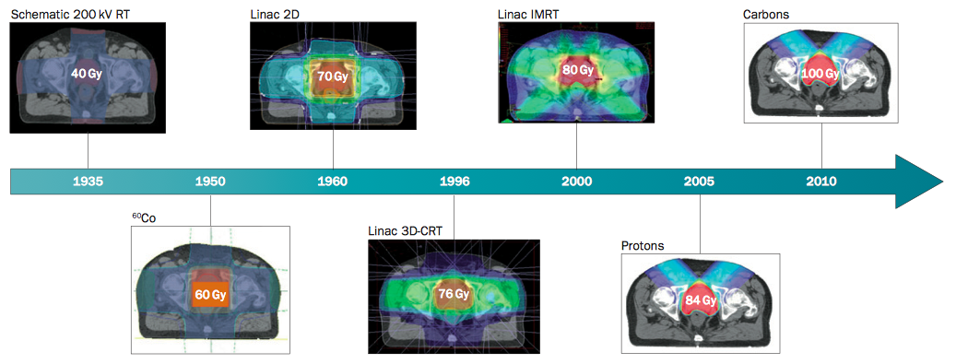
Progression of External Beam Radiation Therapy
Why Radiation Therapy for Cancer?
Radiation kills cells by causing DNA damage that leads to cell inactivation or death
Cells are typically the most sensitive to DNA damage from radiation during reproduction
Cancer cells typically reproduce more quickly than healthy tissues
Thariat, J. et al. Nat. Rev. Clin. Oncol. 10, 52–60 (2013)

Slide 8
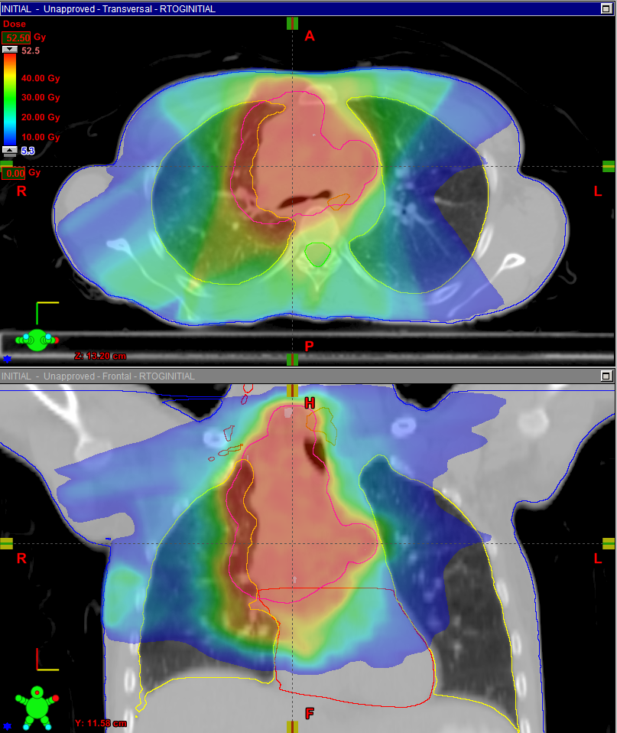
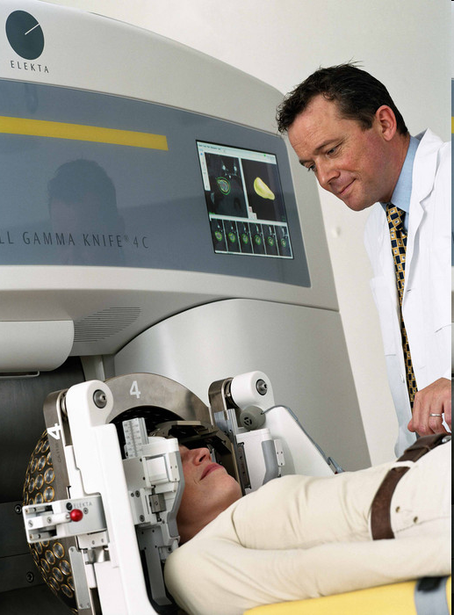
Treatment Planning
Gamma Knife for Brain “Radiosurgery”
Dose to the patient is simulated using radiation transport algorithms that must be fast & accurate
Notes:
radiation transport simulation to understand the tumor location and size and to perform the radio surgery using gamma rays:
Must be fast & accurate.

Slide 9
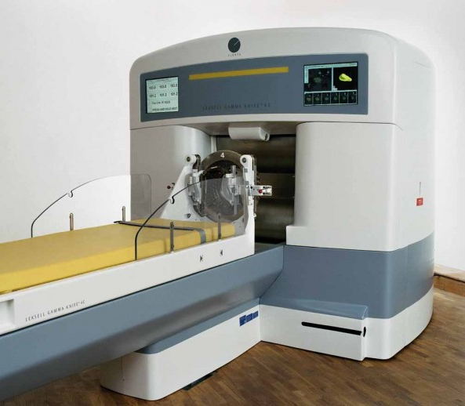
Gamma Knife for Brain “Radiosurgery”

Slide 10
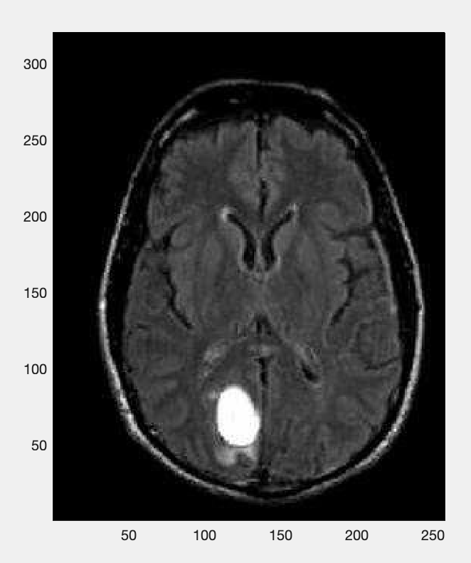
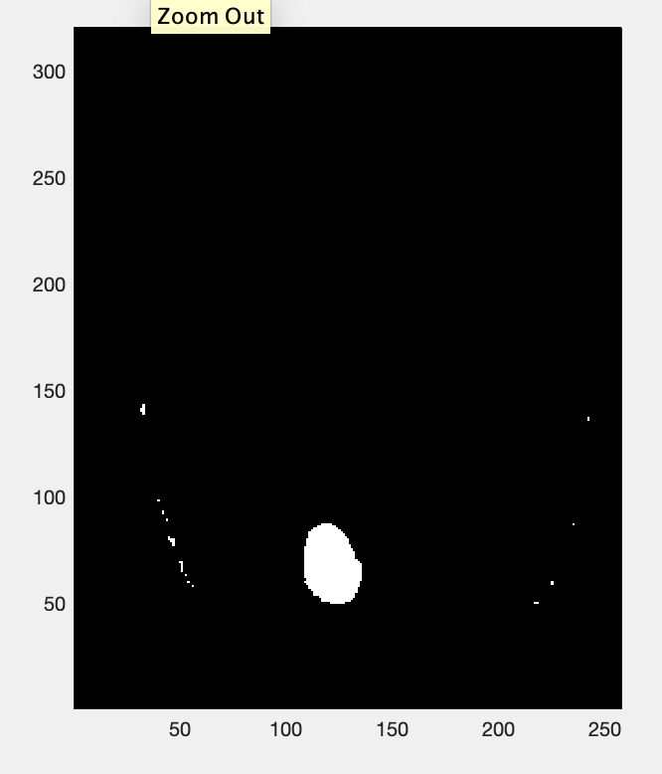
Project 2 Tasks
This is a highly simplified version of treatment planning
There will be a series of patient MRI scans of brains in files labeled patient001mri.jpg etc.
Load sequentially the files (using imread) and process them
Task 1 is to isolate the tumor location

Slide 11
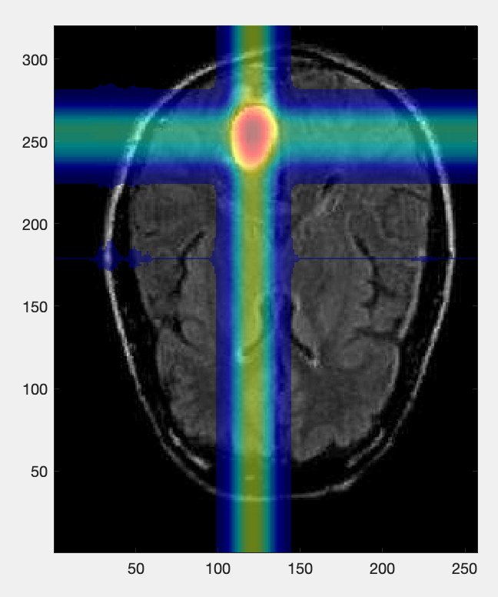
Project 2 Tasks
Bring in virtual radiation beams from two sides - where they cross at the point of the tumor the dose will be maximized
Using the coordinates of the position of the tumor pixels, calculate radiation beam patterns
Notes:
Bring in virtual radiation beams in perpendicular direction

Slide 12
Project 2 Tasks
Calculate the radiation dose absorbed by the tumor (in Gy - Joules per kilogram) compared to how much dose is deposited in surrounding tissue
due Oct. 13th (in 3 weeks!)

Slide 13
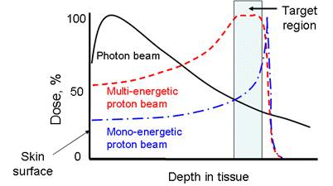
Treatment Beam “Depth Dose Curves”
We are assuming the beam is unattenuated as it passes through the tissue
For the enthusiastic coders - a more realistic model for a photon beam would have it attenuating as: exp(-x/15 [cm])

Slide 14
Contents
Project 2
Midterm 1 review

Slide 15
Summary
MATLAB (“MATtrix LABoratory)
Creating arrays - data types; array operations
Array indexing - logical operation and indexing
Data visualization - 1-D plots; 2-D plots; logical operation for plotting
Statistics - mean and variance; smoothing and curve fitting
Flow control - if-else, switch-case, for/while loops
Other data types - string, cell, structs
Notes:
Central piece is data

Slide 16
Creating arrays
Creating arrays: [] and : operators
Matrix/vector operations vs. array element-wise operations (use . )
Vectorization (operators and functions): speed!
Script and function files
Variable scope
Notes:
[] creates array where data can be entered
: creates array of arithmetic sequence

Slide 17
Array indexing
Array indexing
Use index or range of indices (:) directly
Create an array of indices (e.g., A(:,[1,4]))
Logical variables and logical indexing
Extract/modify elements from the matrix that corresponds to the positions with a ‘true’ value (e.g., M (A == B), A and B should be the same size as M)
Matlab (implicit) typecasting
Demotes interaction between integer and double

Slide 18
Data Visualization
1-D plot (line, scatter, histogram)
when to use log scale
what does histogram represent
2-D plot (contour, image, surface)
how to create 2-D (X-Y) coordinate matrices from 1-D (x-y) arrays
use logical indexing for plotting
Don’t set to NaN if numerical operation of the array is needed

Slide 19
Statistics and Flow Control
Mean and variance
Data smoothing and curve fitting
no function vs explicit function
parameter tuning vs coefficient optimization
Two types of flow control
Selection (if-else, switch-case)
Loop (while, for)
Terminate the current iteration, the whole loop or the function/script

Slide 20
Other Data Types
Ways to create string: character array ‘ ’ vs string array “ ”
Cell array - heterogeneous array
What is the difference between content indexing {} and cell indexing ()
Structs - referenced by “field” with a period
Access filed through name rather than index
struct.field vs cell{3}

Slide 21
More about Midterm 1
Sample exam from previous years
Reference sheet
Will send today
Please print and bring a copy to exam
Room
Chrysler 220
NAME 134 (for those who requested accommodation)

Slide 22
Next lecture
Midterm 1
C++ introduction next Thursday

